Slide 1







TITLE: REPORT ON PREDICTING THE LANDING OF SPACE X FALCON 9 FIRST STAGE.
NAME: BOBBAI THOMAS
DATE: 30/06/2024

Slide 2



OUTLINE
Executive summary
Introduction
Methodology
Data wrangling methodology
Interactive visual analytics
Predictive analysis
Results
Visualization – charts
Sql
Map chart
Dashboard
Predictive
Discussion
Findings
Conclusion
Conclusion and Implication
Appendix

Slide 3

EXECUTIVE SUMMARY
This Report is focusing on the objective of predicting the landing of Space X Falcon 9 if it will be successful or it will crash while landing.
I retrieve the data in two different methods, the first is by web scrapping , using the Request module of python to retrieve the data from Space X API site which is; https://api.spacexdata.com/v4/launches/past which both have a total of 94 rows and 17 columns of data, where columns comprises of; FlightNumber, Date, BoosterVersion, PayloadMass, Orbit, LaunchSite, Outcome, Flights, GridFins, Reused, Legs, LandingPad, Block, ReusedCount, Serial, Longitude and Latitude.

Slide 4
EXECUTIVE SUMMARY
Data wrangling was carryout using both sql and pandas on python, after cleaning and organizing the data, we end up having a total of 90 rows and 80 columns due to the creation of dummy values for categorical columns such as Orbit, Launchsite, Landingpad and Serial column.
Data visualization is being carry out with Dash library for interactive visualization and Folium for Geo spatial representation of data.
Predictive analysis was carry out using classification model such as Logistic Regression, Support Vector Machine, Decision Tree and K-NN. Evaluation of each model was carryout to know the suitable model to predict the landing of Space X Falcon 9.

Slide 5

INTRODUCTION
SpaceX, known for its innovative approaches to space travel, offers Falcon 9 rocket launches at a significantly lower cost of $62 million compared to other providers whose costs can reach upwards of $165 million. A major factor contributing to these savings is SpaceX's ability to reuse the first stage of their rockets. Consequently, predicting the successful landing of the first stage can be crucial in estimating the cost efficiency of a launch. This information becomes particularly valuable for companies considering competing with SpaceX in the space launch market.
Objective
The objective of this report is to create a machine learning pipeline that predicts the successful landing of the Falcon 9's first stage based on available historical data. This prediction model can aid alternate companies in making informed bids against SpaceX by evaluating the potential cost savings and competitive pricing strategies.

Slide 6
METHODOLOGY
Data Collection: Using Python to carry out the task, data were collected from Space X API site (https://api.spacexdata.com/v4/launches/past), the data consist of 94 rows and 17 columns, the columns are; FlightNumber, Date, BoosterVersion, PayloadMass, Orbit, LaunchSite, Outcome, Flights, GridFins, Reused, Legs, LandingPad, Block, ReusedCount, Serial, Longitude and Latitude.
Data Wrangling: The data consist of both Falcon 9 and Falcon 1, therefore we remove the Falcon 1 to focus on only Falcon 9, after doing that, we are left with only 90 rows out of 94.
Missing values: We have two columns with missing values, the columns are; Payload Mass and LandingPad, with each missing 5 and 26 values respectively. Payload Mass missing value is replace with the mean of all the values in the column and missing value on LandingPad column where left that way, representing that the LandingPad is not use.
The number of time each outcome of the landing took place is verify, which is shown on the table. The successful one where assign a value 1 and the unsuccessful one is 0 and with that outcome, a new column is added making the dataset to have 18 column.
OUTCOME | COUNT | CLASS
True ASDS | 41 | 1
None None | 19 | 0
True RTLS | 14 | 1
False ASDS | 6 | 0
True Ocean | 5 | 1
False Ocean | 2 | 0
None ASDS | 2 | 0
False RTLS | 1 | 0

Slide 7
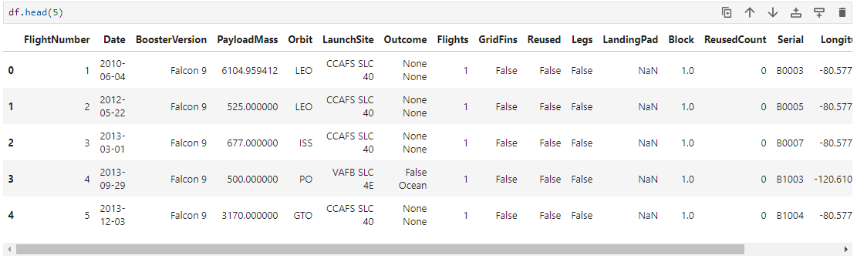
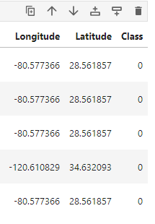
METHODOLOGY
BRIEF SUMMARY OF THE DATASET

Slide 8
METHODOLOGY
EXPLOTARY DATA ANALYSIS: Using Visualization to shop relationship between some of the attributes, the visualization are carried out base on the following using Python Matplotlib and Seaborn:
Pay Load Mass VS Flight Number: this visualization shows the Payload Mass base on the Flight Number focusing on the success rate using Scatter Chart.
Launch Site VS Flight Number: The visualization shows the Launchsite base on Flight Number focusing on the success rate using Scatter Chart.
Launch Site VS Pay Load Mass: This is to know if the load mass have a significant effect on Launch Site focusing on the success rate using Scatter Chart.
Success Rate VS Orbit type: This is to know if there is any relationship between the two.
Flight Number VS Orbit type: We want to see if there is any relationship between FlightNumber and Orbit type focusing on the success rate using Scatter Chart..
Payload vs. Orbit: Scatter point charts to reveal the relationship between Payload and Orbit type focusing on the success rate.
Year VS Success Rate: This will reveal the relationship between the Year and Success Rate, using line chart.

Slide 9
METHODOLOGY PREDICTIVE ANALYSIS
Several machine learning models were trained and tested to predict the successful landing of the first stage of the Falcon 9. The models included in the evaluation were:
K-Nearest Neighbors (KNN)
Decision Tree
Support Vector Machine (SVM)
Logistic Regression
The dataset used for training these models consisted of historical launch data, including features such as launch site, payload mass, orbit, and other relevant parameters.

Slide 10
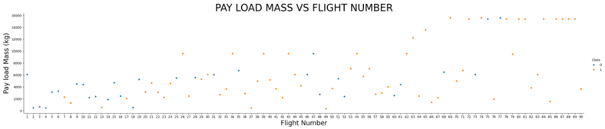
RESULTS EDA VISUALIZATION

Slide 11
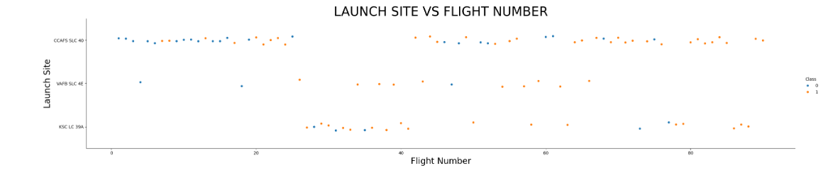
RESULTS EDA VISUALIZATION

Slide 12
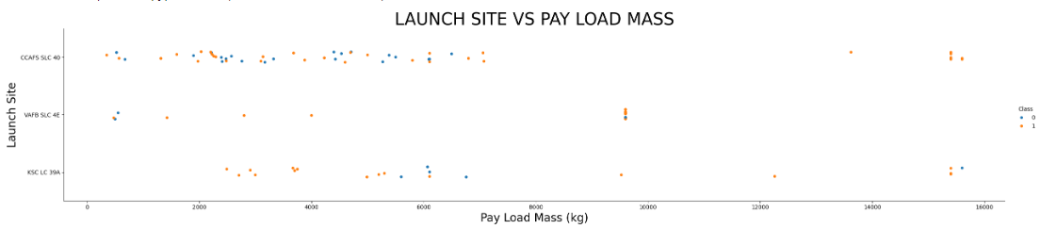
RESULTS EDA VISUALIZATION

Slide 13
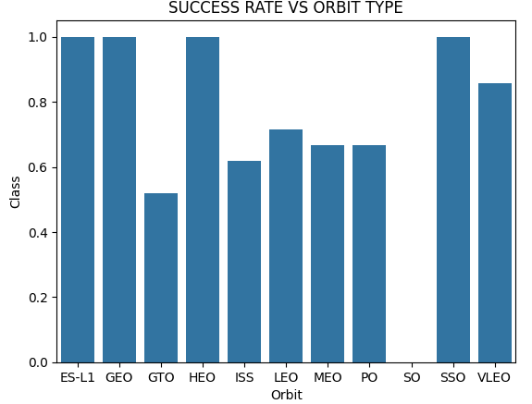
RESULTS EDA VISUALIZATION

Slide 14
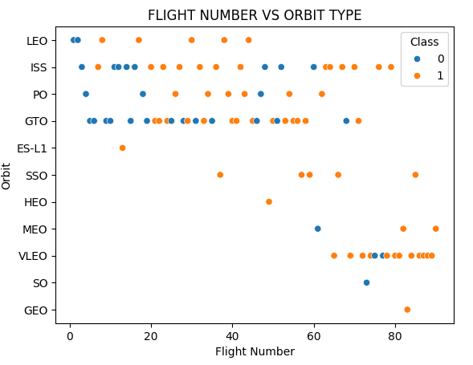
RESULTS EDA VISUALIZATION

Slide 15
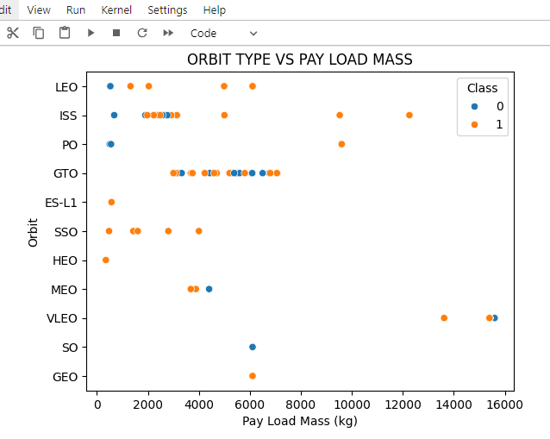
RESULTS EDA VISUALIZATION

Slide 16
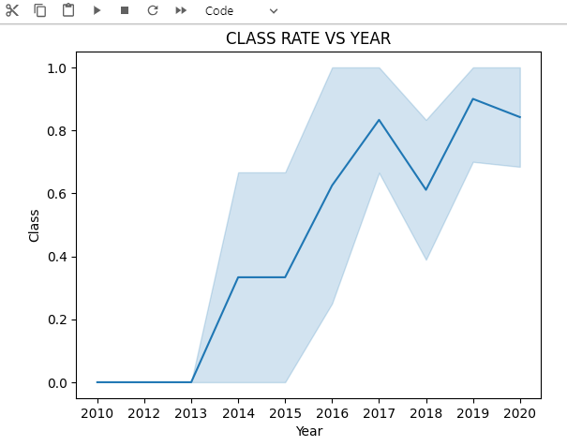
RESULTS EDA VISUALIZATION

Slide 17
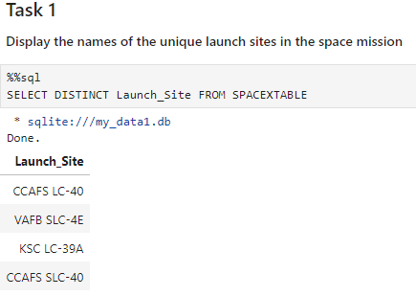
RESULTS EDA SQL RESULTS

Slide 18
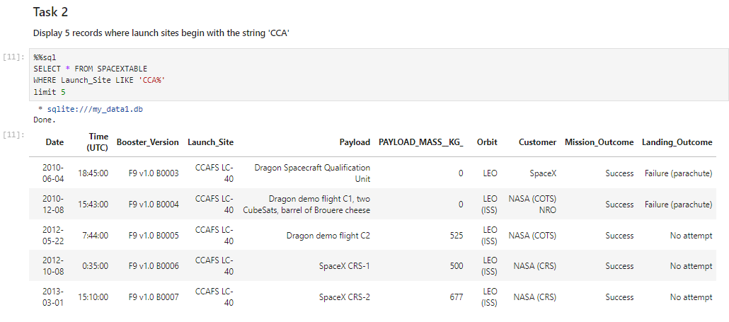
RESULTS EDA SQL RESULTS

Slide 19
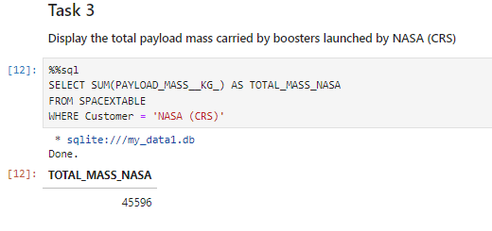
RESULTS EDA SQL RESULTS

Slide 20
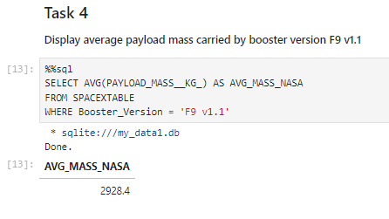
RESULTS EDA SQL RESULTS

Slide 21
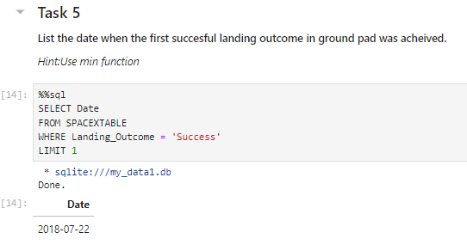
RESULTS EDA SQL RESULTS

Slide 22
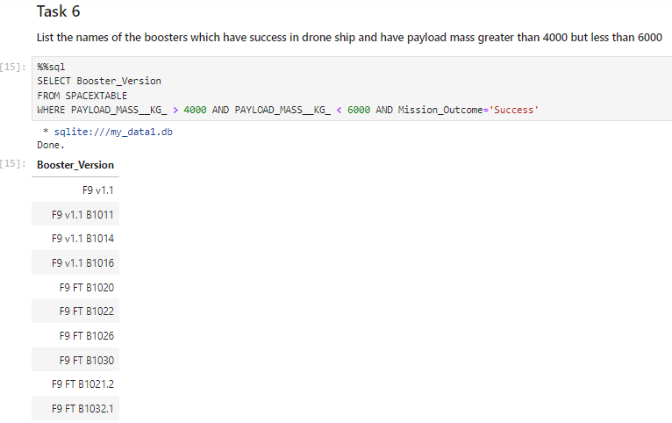
RESULTS EDA SQL RESULTS

Slide 23
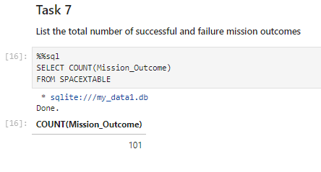
RESULTS EDA SQL RESULTS

Slide 24
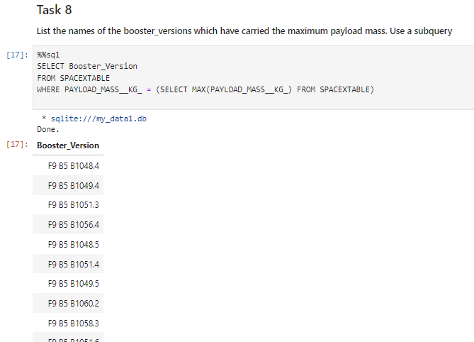
RESULTS EDA SQL RESULTS

Slide 25
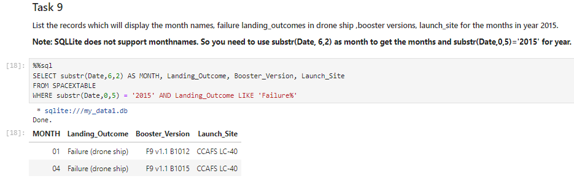
RESULTS EDA SQL RESULTS

Slide 26
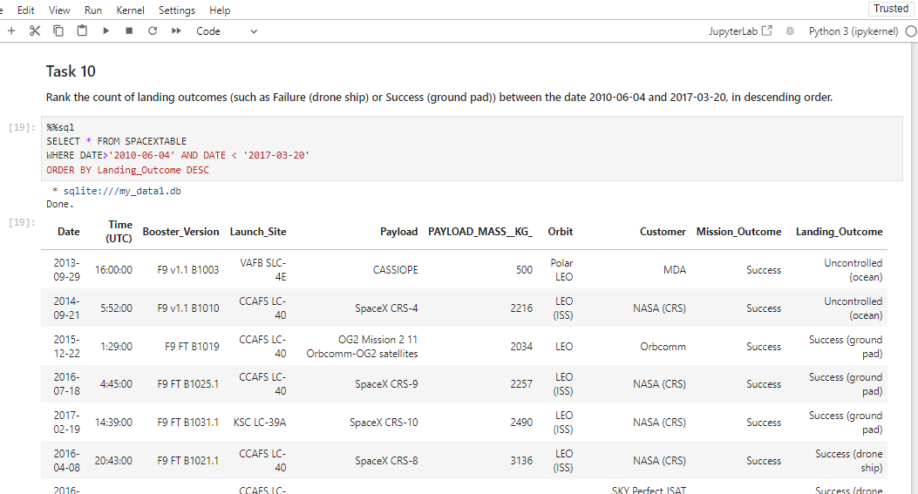
RESULTS EDA SQL RESULTS

Slide 27
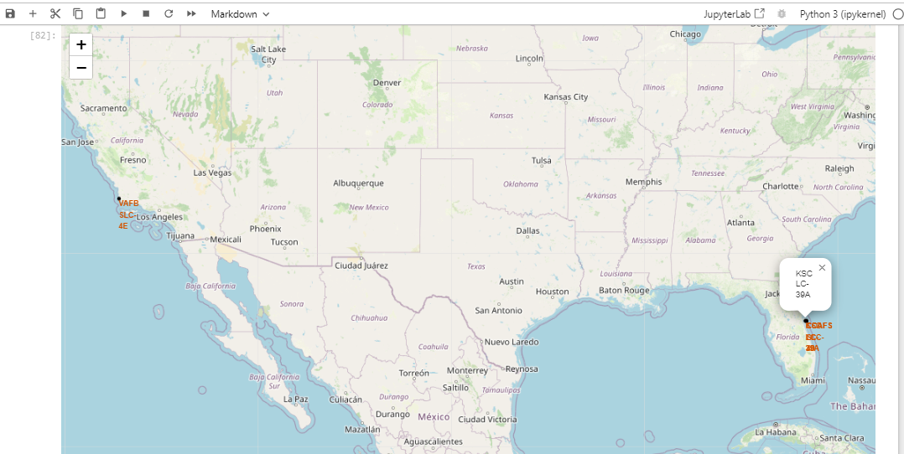
RESULTS MAP WITH FOLIUM RESULTS MAP WITH MARKED LAUNCH SITES

Slide 28
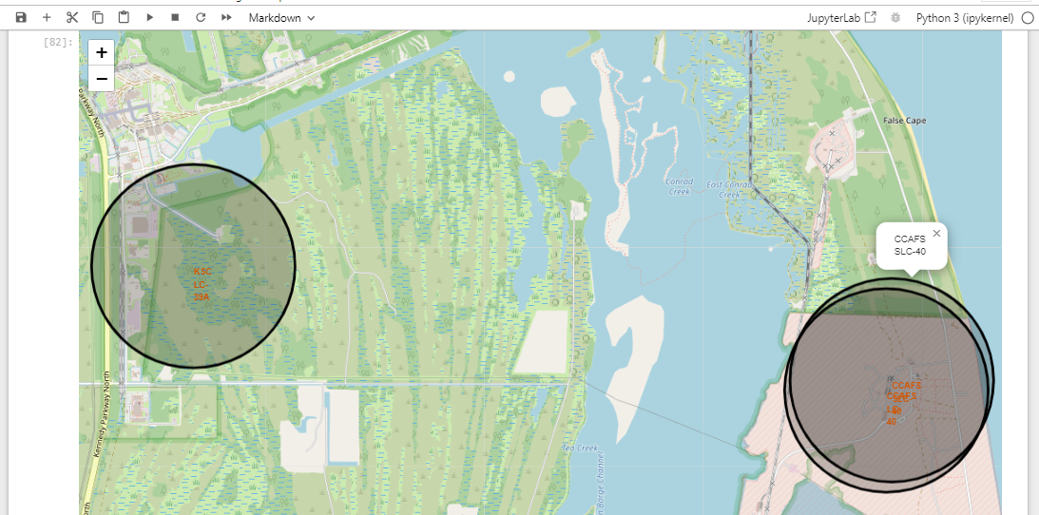
RESULTS MAP WITH FOLIUM RESULTS MARKING THE SUCCESS/FAIL LAUNCHSITE

Slide 29
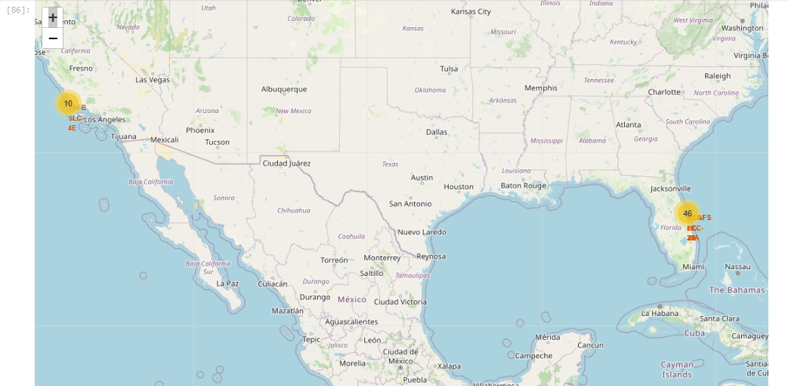
RESULTS MAP WITH FOLIUM RESULTS MARKING THE SUCCESS/FAIL LAUNCHSITE

Slide 30
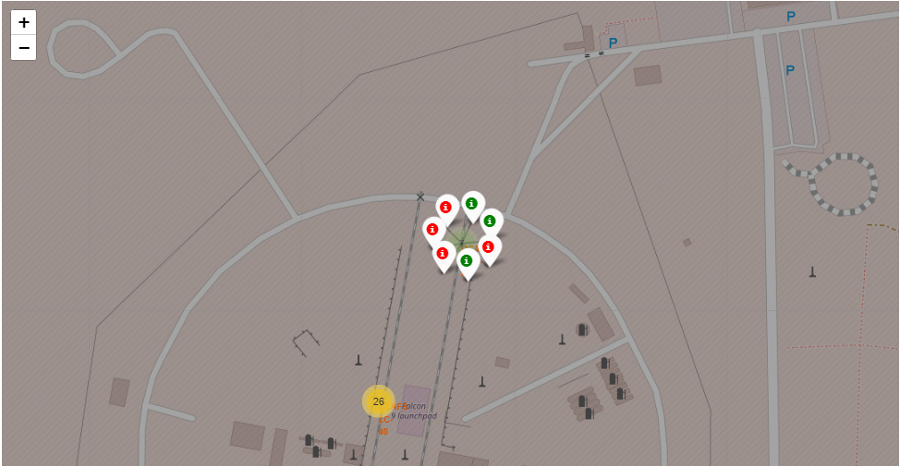
RESULTS MAP WITH FOLIUM RESULTS MARKING THE SUCCESS/FAIL LAUNCHSITE

Slide 31
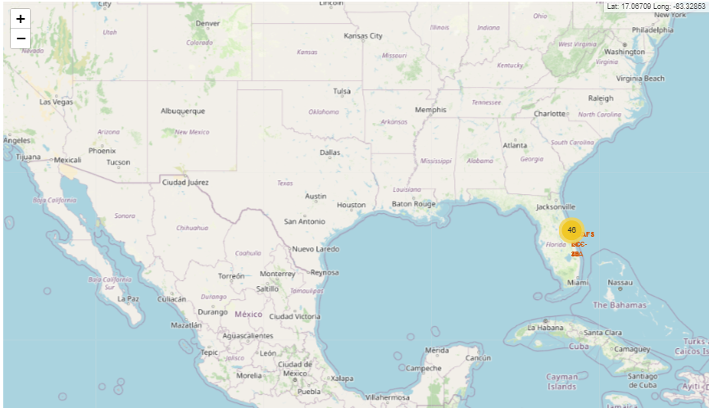
RESULTS MAP WITH FOLIUM RESULTS MOUSE POSITION ADDED

Slide 32
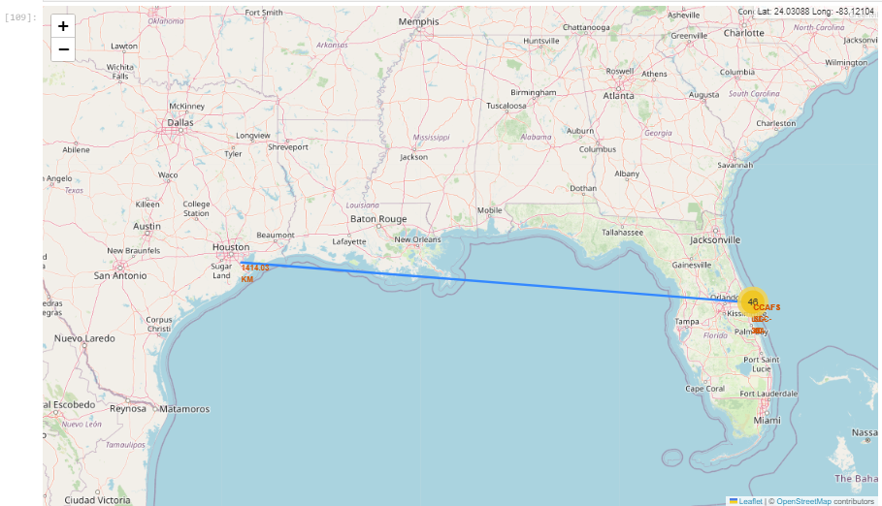
RESULTS MAP WITH FOLIUM RESULTS CREATING POLYLINE LAUNCH SITE TO COASTAL LINE WITH DISTANCE CALCULATED

Slide 33
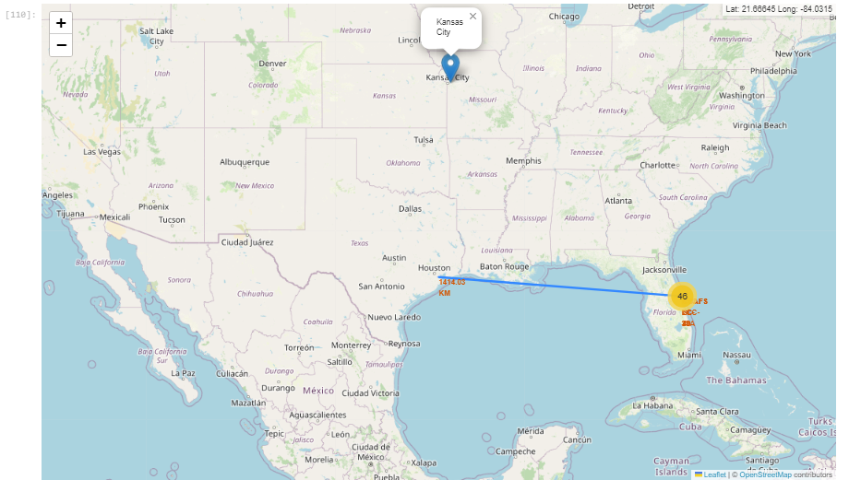
RESULTS MAP WITH FOLIUM RESULTS MARKER FOR KANSAS CITY

Slide 34
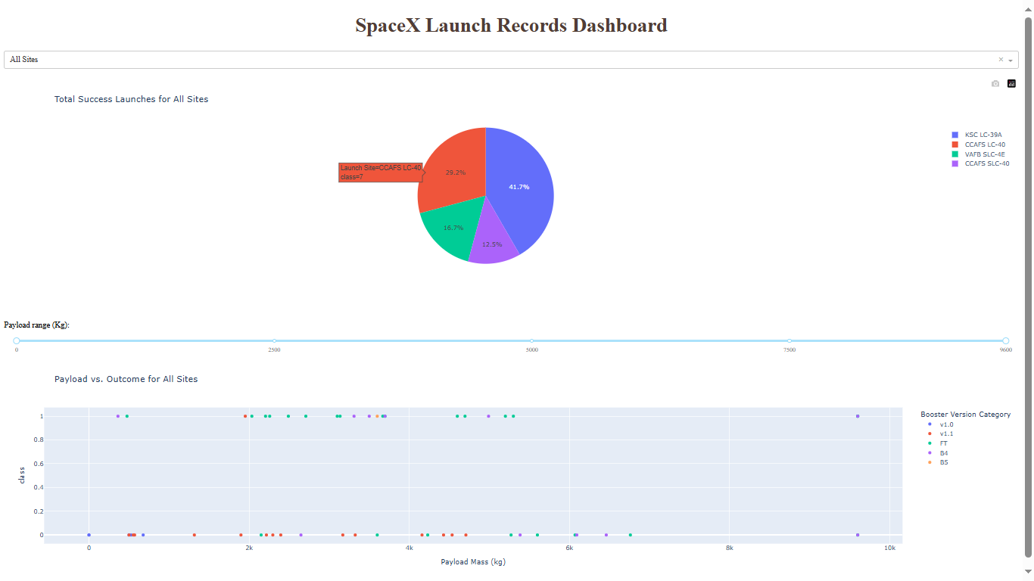
RESULT DASH VISUALIZATION

Slide 35
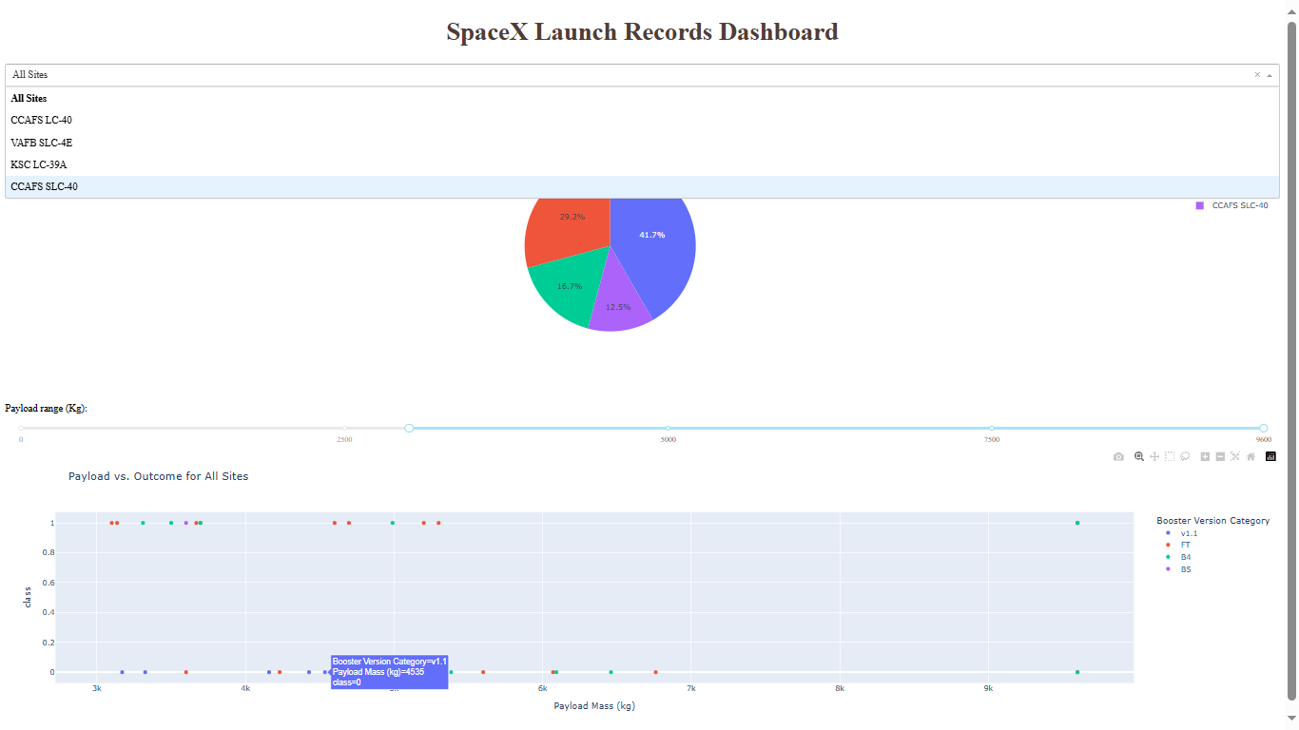
RESULTS DASH VISUALIZATION

Slide 36
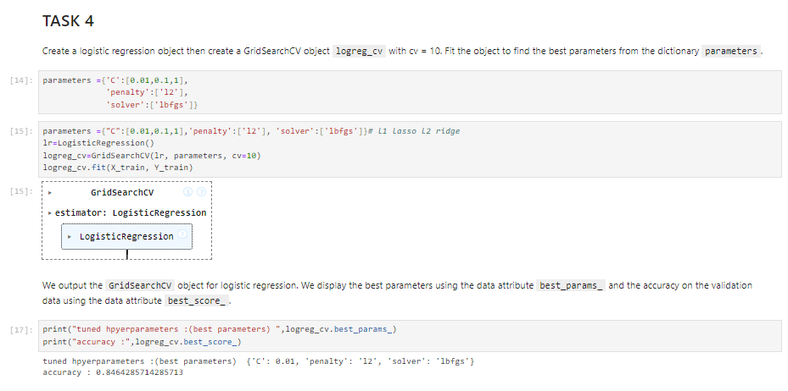
RESULTS PREDICTIVE ANALYSIS RESULTS

Slide 37
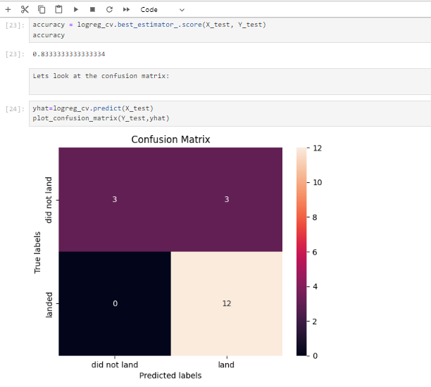
RESULTS PREDICTIVE ANALYSIS RESULTS

Slide 38
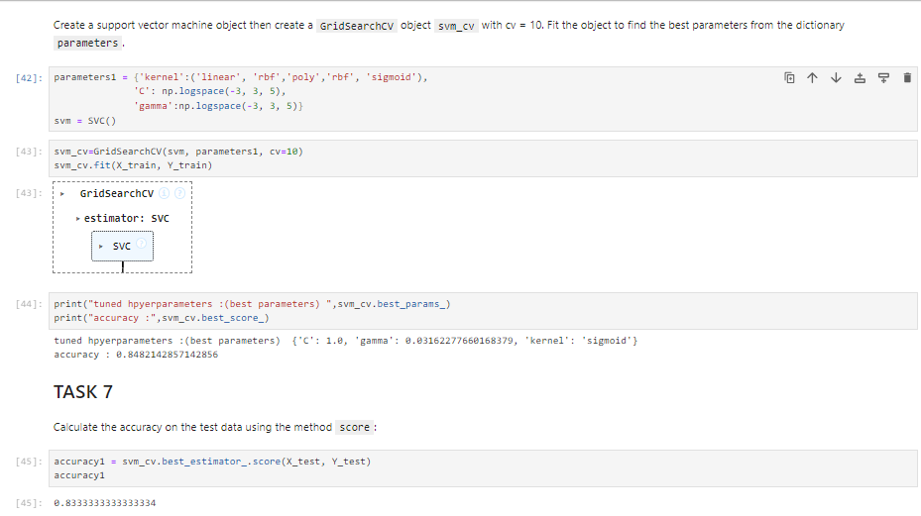
RESULTS PREDICTIVE ANALYSIS RESULTS

Slide 39
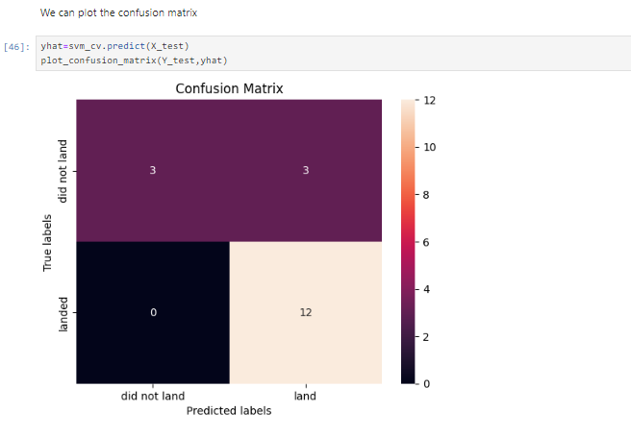
RESULTS PREDICTIVE ANALYSIS RESULTS

Slide 40
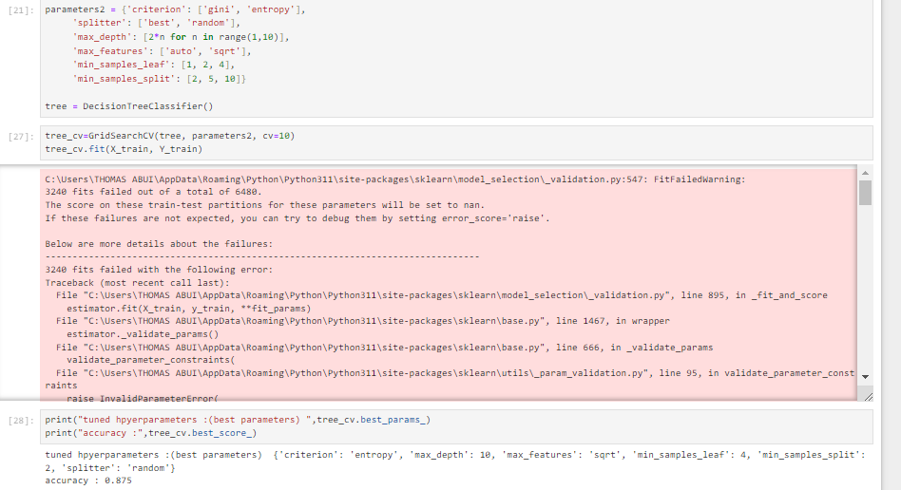
RESULTS PREDICTIVE ANALYSIS RESULTS

Slide 41
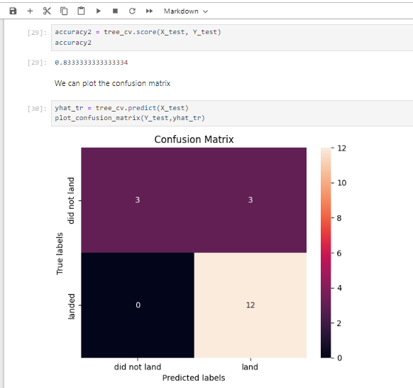
RESULTS PREDICTIVE ANALYSIS RESULTS

Slide 42
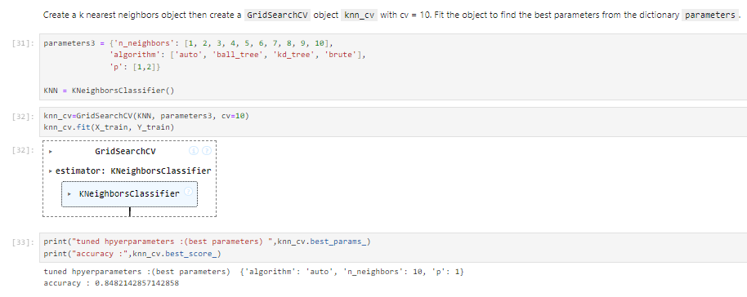
RESULTS PREDICTIVE ANALYSIS RESULTS

Slide 43
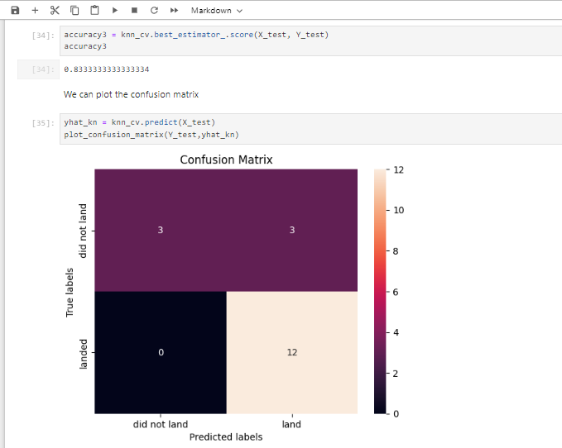
RESULTS PREDICTIVE ANALYSIS RESULTS

Slide 44
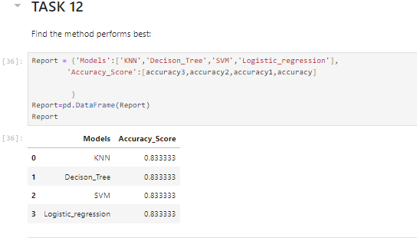
RESULTS PREDICTIVE ANALYSIS RESULTS

Slide 45
DISCUSSION
All four models achieved an accuracy score of approximately 83.33%. This indicates that each model has a similar capability in predicting the landing success of the Falcon 9's first stage.
K-Nearest Neighbors (KNN): This model relies on the similarity between data points. Its high accuracy suggests that historical launch data have distinct patterns that can be effectively used for prediction.
Decision Tree: This model works by making decisions based on the values of input features. Its performance indicates that the criteria used to make these decisions are robust and relevant to the outcome.
Support Vector Machine (SVM): SVM tries to find the best boundary that separates different classes. Its comparable accuracy shows that the decision boundary between successful and unsuccessful landings is well-defined in the feature space.
Logistic Regression: This model predicts probabilities of binary outcomes. Its effectiveness suggests that the probability distribution of features between successful and unsuccessful landings is distinguishable.

Slide 46
CONCLUSION
The models developed provide a reliable prediction (83.33% accuracy) of the Falcon 9 first stage landing success. This predictive capability is crucial for companies looking to compete with SpaceX by estimating the potential cost savings and setting competitive prices for rocket launches.
Implications
By using these models, alternate companies can:
Assess the risk and feasibility of achieving cost-effective launches by predicting the likelihood of the first stage landing success.
Make data-driven decisions to optimize their launch strategies and cost structures.
Develop competitive bids against SpaceX by accurately estimating potential savings from reusable first stages.

Slide 47

APPENDIX
https://api.spacexdata.com/v4/launches/past

